Slide 1
Reinforcement Learning Project -
Shlomi Friedman | Kfir Amoyal

Slide 2
Reward Shaping Functions
1. Step-Cost Shaping
Adds a small negative reward (−0.01) for every step.
Encourages shorter paths and provides dense, continuous feedback.
2. Potential-Based Distance Shaping
Uses negative Manhattan distance to the goal as a potential function.
Rewards moves that reduce distance and penalizes moves away from the goal
3. Safe Position Reward
Rewards states far from holes and penalizes risky or terminal positions.
Reduces failure risk in slippery, stochastic environments.
4. Safe Progress Reward
Combines goal progress with safety-aware rewards.
Encourages paths that balance efficiency and risk avoidance.

Slide 3
HyperParameters
Learning rate (α): 0.1
Discount factor (γ): 0.95
Initial ε: { 0.05, 0.1, 0.2 }
Minimum ε: 0.01
ε decay: 0.0
Episodes: 10,000
Max steps per episode: 200
Environment: Frozen Lake 7x7
Slippery dynamics: True
Shaping decay: 0.95
Shaping strength: 0.1

Slide 4
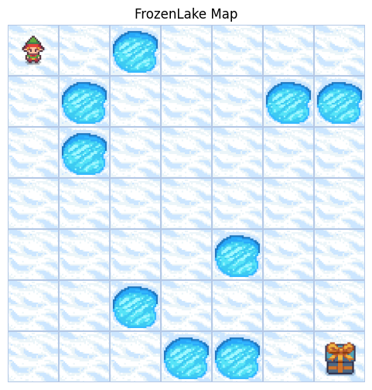
Our Frozen Lake

Slide 5
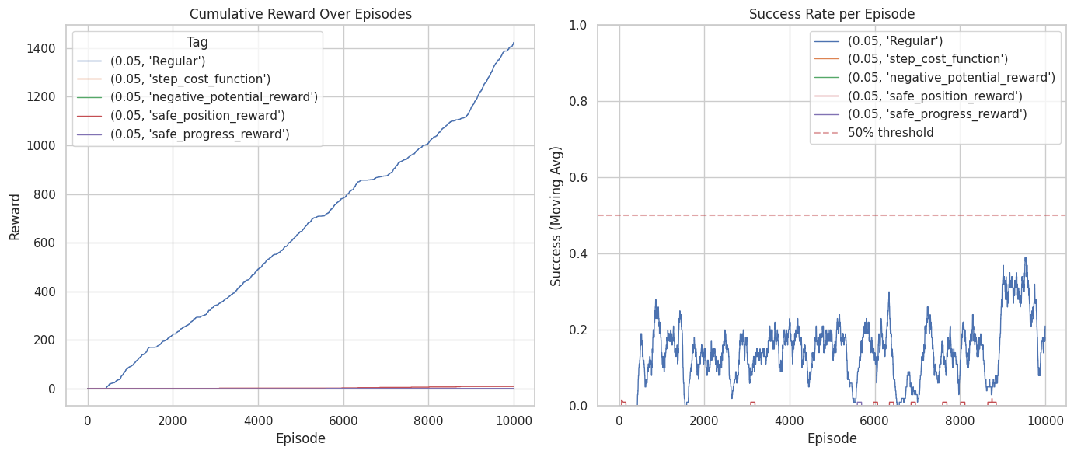
Epsilon = 0.05 (MC)
Valid policy:
Regular: V
Step Cost: X
Negative Potential: X
Safe Position: X
Safe Progress: X

Slide 6
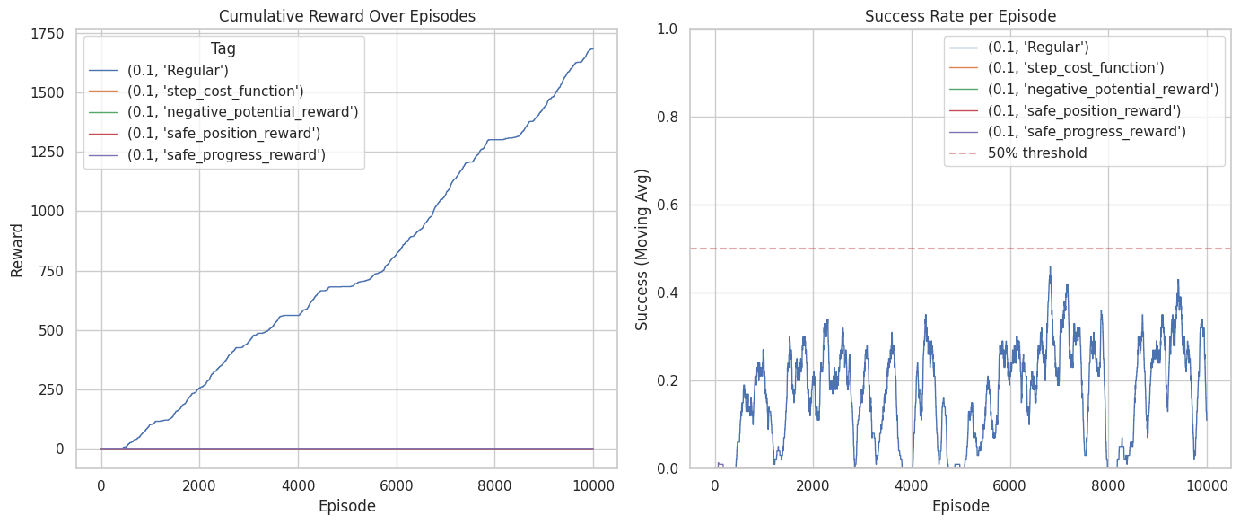
Epsilon = 0.1 (MC)
Valid policy:
Regular: V
Step Cost: X
Negative Potential: X
Safe Position: X
Safe Progress: X

Slide 7
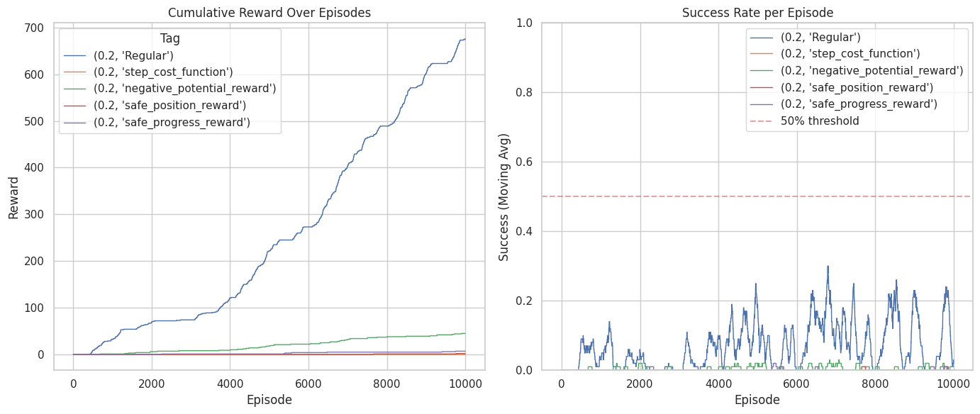
Epsilon = 0.2 (MC)
Valid policy:
Regular: V
Step Cost: X
Negative Potential: X
Safe Position: X
Safe Progress: X

Slide 8
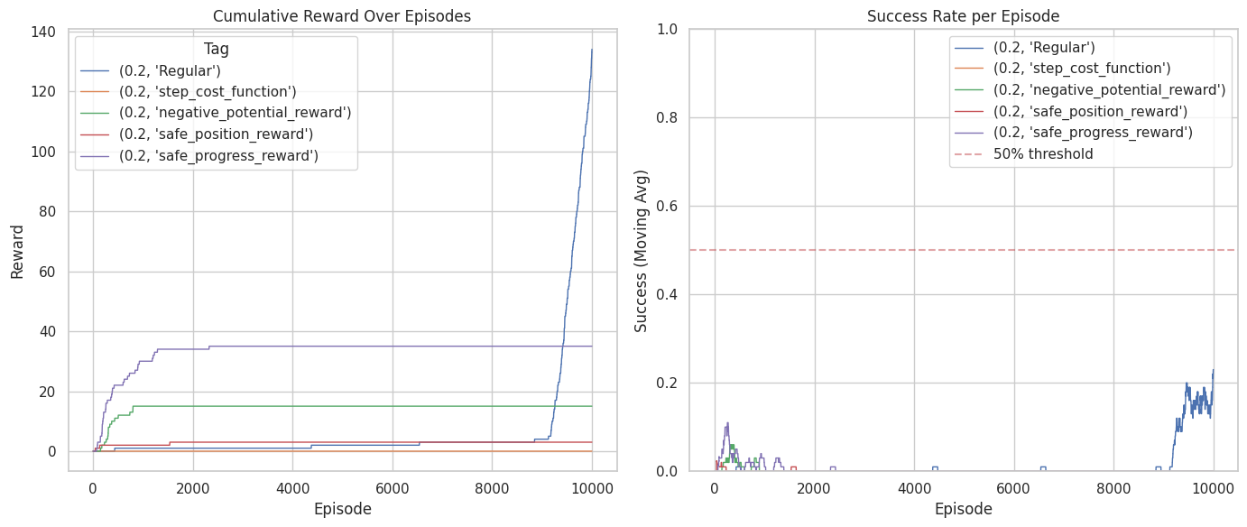
Epsilon = 0.2 (SARSA(0))
Valid policy:
Regular: V
Step Cost: X
Negative Potential: X
Safe Position: X
Safe Progress: X

Slide 9
Finding/Insights
No reward shaping performed best:
The regular reward function achieved the highest performance, especially with the MC agent.
Custom reward shaping functions were ineffective:
All the custom function often discouraged reaching the goal, either by reducing motivation, favoring misleading local rewards, or overly avoiding risky (but necessary) paths.
Exploration matters more with shaping:
Higher ε increased the chance to reach the goal for shaped rewards, but still did not outperform the no-shaping baseline.
Algorithm comparison:
MC outperformed SARSA(0) with no shaping.
SARSA(0) showed slight improvement with Safe Progress, but not enough to justify its use.

Slide 10
Conclusions (1/2)
Across 20 independent runs, results revealed counterintuitive effects of reward shaping, challenging common assumptions in reinforcement learning.
Identified failure modes per strategy:
  Step cost: Demotivated the agent on long paths, conflicting with goal completion.
  Potential-based distance: Trapped the agent in local optima based on Manhattan distance.
  Safe position: Overly conservative behavior, avoiding necessary risky moves.
  Safe progress: Combined conservatism with local-optima issues.

Slide 11
Conclusions (2/2)
Main takeaway:
Reward shaping is not universally beneficial. In stochastic, sparse-reward environments, simpler reward structures can outperform complex shaping.
Practical implication:
Effective shaping requires tight alignment with the true task objective; misalignment introduces competing incentives that degrade performance.

Slide 12

Thank You
Shlomi & Kfir

